Slide 1

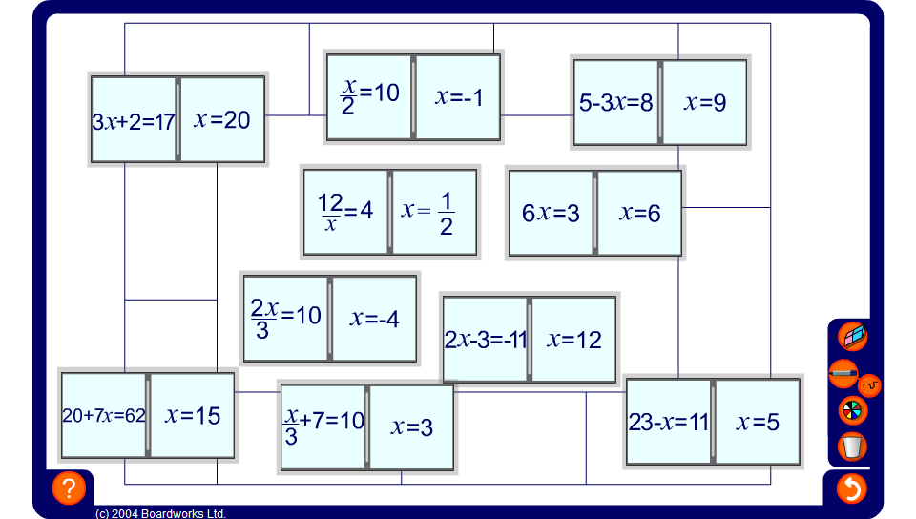


Equation dominoes
Notes:
Choose a volunteer to come to the board and move the dominoes into place.
Members of the class must tell the volunteer where to place the dominoes so that the correct solutions are connected to the corresponding equation. Encourage pupils to use substitution to check their suggestions.

